Slide 1



Data Structure
Course Code: 102040304
Branch : Computer Engineering (CP2)
Semester: III
Batch: C
Teammates:
1. Makwana Richa Manishbhai (12502040501121)
2. Patel Richi Devendra (12502040501122)
3. Solanki Ridham Dipakkumar (12502040501123)
“Sorting, Bubble sort, and Quick sort

Slide 2
What is Sorting ?
Sorting is the process of arranging data in a particular order.
  Ascending Order: Smallest to largest
  Descending Order: Largest to smallest
Why Do We Need Sorting?
  Makes data easier to understand and organize.
  Helps in searching data faster.
  Makes comparing data easier.
Important Terms
  In – Place Sorting : Sorts data using very little extra memory, usually by rearranging elements in the original data structure.
  Stable Sorting: Maintains the relative order of equal elements after sorting.
Unsorted
4
2
1
3
5
Sorted
1
2
3
4
5

Slide 3
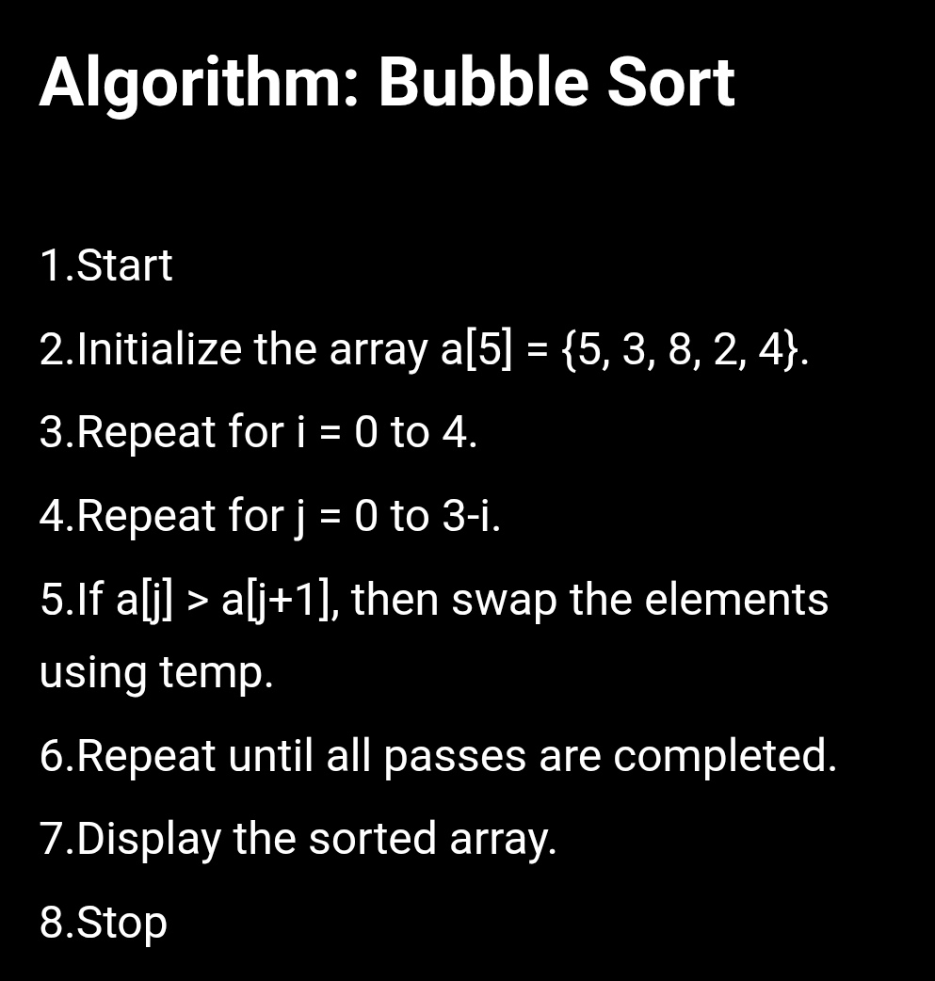
What is Bubble Sort?
A simple comparison-based sorting algorithm.
It repeatedly compares adjacent elements and swaps them if they are in the wrong order.
After each pass, the largest element “bubbles up” to its correct position at the end.
➢ Key Points
Needs n − 1 passes for n elements (at most).
In-place: yes. Stable: yes.
Simple to understand, but slow for large data.
Complexity
Best Case: O(n) — when the array is already sorted, with an optimized version.
Average Case: O(n²)
Worst Case: O(n²)

Slide 4
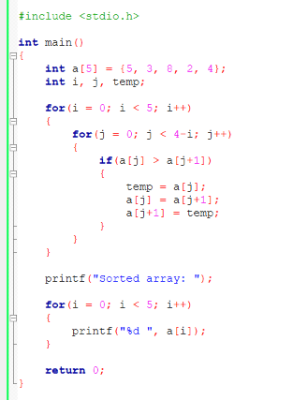
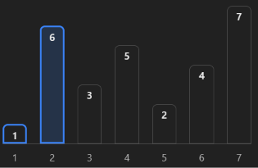
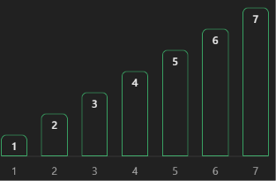

C Program : Bubble Sort
Sorting Order: Ascending order . Each pass moves the largest unsorted element to the end. And for Stable Sort elements maintain their relative order.
Unsorted Sorted
Output-

Slide 5
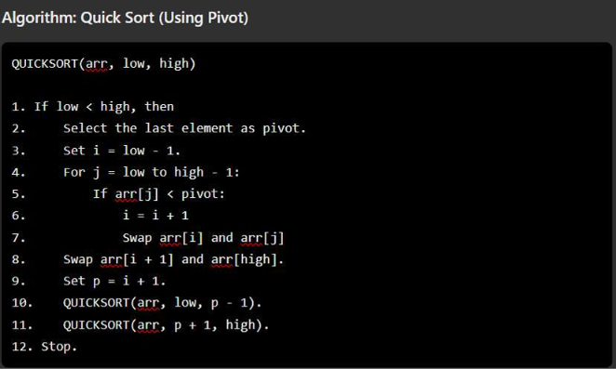
Quick sort
What is Quick Sort?
A fast, comparison-based sorting algorithm.
It selects an element called the pivot and divides the array into two parts.
Elements smaller than the pivot go to the left, and larger elements go to the right.
The same process is repeated for both parts until the array is sorted.
Key Points
Uses the divide-and-conquer technique.
In-place: generally yes, for standard implementations.
Stable: no, in its usual implementation.
Usually fast for large datasets.
Complexity
Best/Average Case: O(n log n)
Worst Case: O(n2)
In-place: Usually yes, apart from recursion stack space.
Stable: No, in its standard implementation.

Slide 6
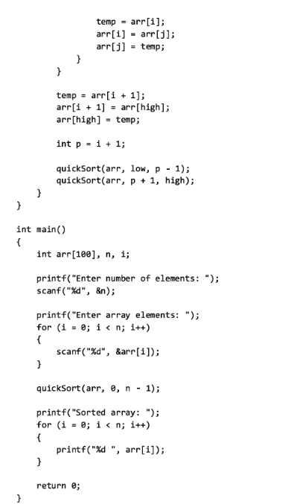
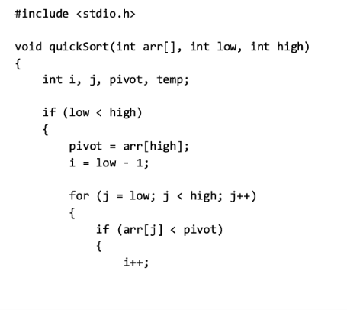
C Program : Quick Sort
Sample Output​
Enter number of elements: 5​
Enter array elements: 5 3 8 2 4​
Sorted array: 2 3 4 5 8​
​

Slide 7
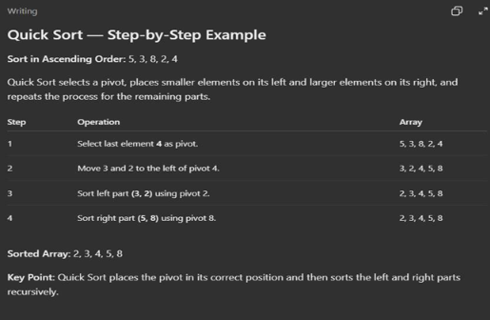
Quick Sort Example :

Slide 8
Bubble Sort vs Quick Sort
Basis | Bubble Sort | Quick Sort
Technique | Comparison & swapping | Divide & conquer
Working | Compares adhacent elements & Swaps them | Selects a pivot & Partitions the array
Best Case | O(n) | O(n log n)
Average Case | O(n2) | O(n log n)
Worst Case | O(n2) | O(n2)
Space Complexity | O(1) | O(log n)
In - space | Yes | Generally Yes
Stable | Yes | No
Speed | Slow for the large datasets | Usually faster for the large datasets
Difficulty | Easy to understand and implement | More complex
Best Use | Small or nearl | Large datasets in general – purpose sorting

Slide 9
Thank you...

